Slide 1
Emitter Follower
Delivered by
MD. Firoz Ahmed
Lecturer, Department of I.C.E, R.U

Slide 2
Negative feedback
Negative feedback:
    When the feedback energy (voltage or current) is out of phase with input signal and thus opposes it, it is called Negative feedback.
    Negative feedback reduces the gain of the amplifier.
    Advantages of Negative feedback:
      Reduction in distortion.
      Stability in gain.
      Increased in bandwidth.
      Improved input and output impedance.

Slide 3
Emitter Follower
Emitter follower:
Definition: When the output is taken from the emitter terminal of the transistor as shown in fig.1, the network is referred to as an Emitter Follower.
The output voltage is always slightly less than the input signal due to the drop from base to emitter but the approximation voltage gain (≈1) is usually a good one.
    The emitter follower is a negative current feedback circuit.
    The emitter follower is a current amplifier that has no voltage gain.
    The voltage gain of an emitter follower (also known as common-collector amplifier) is approximately unity.
    Its important characteristics is that it has high input impedance (100 kΩ) and low output impedance (20Ω). This makes it an ideal circuit for impedance matching. (useful for impedance matching)
    It also exhibits high current gain, high power gain.
    It is called emitter follower because the input signal follows through the emitter load with both in magnetic and phase unchanged.
    It has low voltage gain (≈1).
    It has high current gain (-50).
    In practice, the voltage gain of an emitter follower is between 0.8 and 0.999.

Slide 4
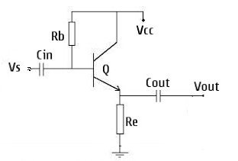
Fig.1

Slide 5
Emitter Follower
Emitter Follower:
    Emitter Follower is also called as Negative current feedback circuit.
    This circuit exhibits a large Input Impedance, a small output Impedance, and a voltage gain of approximately Unity.
    Further the output voltage tends to be in phase with the Input Voltage hence the term FOLLOWER.
    At first glance, one might be tempted to dismiss such a circuit as useless because of its unity Voltage gain.
    However, its Input and output Impedances promote its use as Input and output buffer stages in amplifier systems.

Slide 6
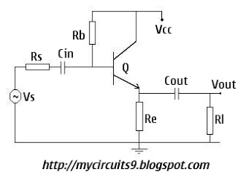
The circuit of an Emitter Follower is shown below:-

Slide 7
    The main difference between an Emitter Follower and conventional amplifier is the absence of Collector Load and Emitter bypass Capacitor.
    The emitter resistance Re itself act as the Load and the ac output voltage Vout is taken across it.
    The biasing is provided either by base resistor method or potential divider method.
    Stabilization of operating point is exceptionally good because of high value of emitter resistance Re.

Slide 8
Design an Emitter Follower Stage
We will design two circuits using a bipolar (BJT) transistor:
    The DC coupled emitter follower
    The AC coupled emitter follower
    Here, we discuss the AC coupled emitter follower:

Slide 9


Circuit details
Fig.10 shows the circuit of an Emitter follower.
    It differ from the circuitry of a conventional CE amplifier by the absence of collector load and emitter bypass capacitor.
    The Emitter resistance itself acts as the load and a.c output voltage (Vout) is taken across
    The biasing is generally provided by voltage-divider method or by base-resistor method.
    The following points are worth noting about the Emitter follower:
        There is neither collector resistor in the circuit nor there is Emitter by-pass capacitor .These are two circuit recognition feature of the Emitter follower.
        Since the Collector is at a.c ground, this circuit is also known as Common collector (CC) amplifier.

Slide 10
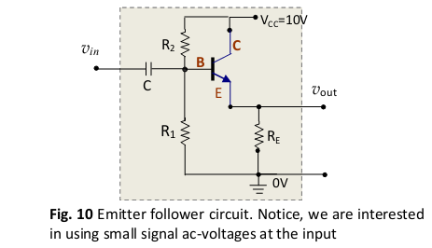
Fig.10: the circuit of an Emitter follower

Slide 11
OPERATION OF EMITTER FOLLOWER
OPERATION OF EMITTER FOLLOWER:
    When input signal Vs is applied to the base, the resulting a.c emitter current Ie develops an output voltage equal to IeRe across the emitter resistance Re.
    This voltage opposes the input voltage ( the ac signal voltage) Vs as it is in phase opposition to Vs.
    Thus it provides negative current feedback.
    Moreover, this voltage (Vout) feedback to the input is proportional to the emitter current hence this circuit is called NEGATIVE CURRENT FEEDBACK CIRCUIT.

Slide 12
    It may be noted that when the input signal voltage Vs goes through its positive half cycle the output voltage Vout is also seen to go through its positive half cycle.
    Hence the output voltage is in phase with the input signal voltage.
    i.e.; The output voltage (emitter voltage) just follows the input voltage and hence the name emitter follower.

Slide 13
Major Characteristics of an emitter follower
Major Characteristics of an emitter follower are:
    (i) No voltage gain. In fact, the voltage gain of an emitter follower is close to 1.
    (ii) Relatively high current gain and power gain.
    (iii) High input impedance and low output impedance.
    (iv) Input and output ac voltages are in phase.

Slide 14
ADVANTAGES OF EMITTER FOLLOWER
Emitter Follower's having a numerous merits some of them is depicted below:-
    High Input Impedance and Low Output Impedance, so it can be used for IMPEDENCE MATCHING.
    sometimes it is called as Impedance Transformer.
    Having 100% Feedback so the output is distortion less and Bandwidth is very Large.
    Relatively High current gain and Power gain.
    Output and Input ac voltages are in Phase and also approximately equal in magnitude.
    Emitter output voltage closely follows the input so it is called as Emitter Follower.

Slide 15
APPLICATIONS OF EMITTER FOLLOWER
The Emitter follower has the following principle applications:
    To provide current amplification with no voltage gain.
    Impedance matching.

Slide 16
APPLICATIONS OF EMITTER FOLLOWER
    Because of High Input Impedance and Low output Impedance an emitter follower is capable of transferring maximum power from High Impedance source to low Impedance Load.
    When an emitter is employed for this purpose, it is called a buffer amplifier.
    There are many instances (especially in digital electronics) where an increase in current is required but no increase in voltage is required.
    For such situations Emitter Follower, because of its High Current Gain, can be employed.

Slide 17
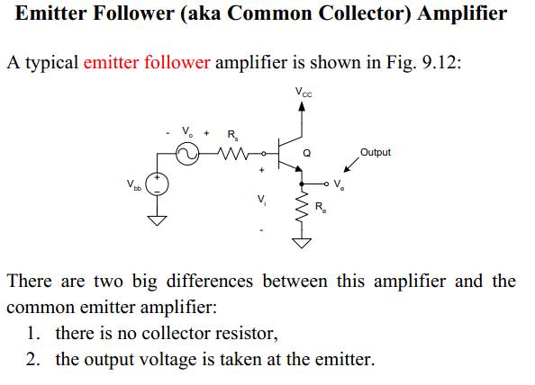

Slide 18
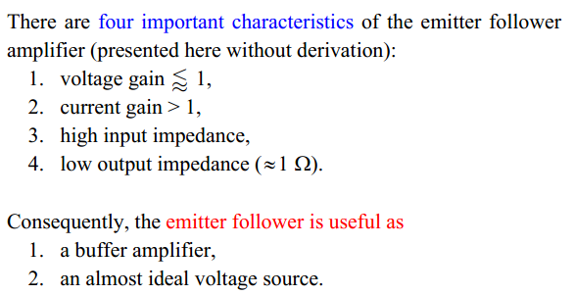

Slide 19
General Characteristics
What are some of the general characteristics of the emitter follower circuit?
Ans.
    Voltage gain is slightly less than unity
    High input impedance
    Low output impedance
  The slight loss of voltage gain sounds like a disadvantage but the stage does however have power gain. This makes it a good buffer stage.
  The high input impedance allows weak signals to be buffered.
  The emitter follower with its high input impedance and relatively low output impedance, makes it a good impedance adapter.

Slide 20
Emitter follower to observe frequency response.
Frequency response:
Frequency response of an amplifier is defined as the variation of gain with respective frequency.
The gain of the amplifier increases as the frequency increases from zero till it becomes maximum at lower cut-off frequency and remains constant till higher cut-off frequency and then it falls again as the frequency increases.
At low frequencies the reactance of coupling capacitor is quite high and hence very small part of signal will pass through from one stage to the next stage.
At high frequencies the reactance of inter electrode capacitance is very small and behaves as a short circuit. This increases the loading effect on next stage and service to reduce the voltage gain due to these reasons the voltage gain drops at high frequencies.
At mid frequencies the effect of coupling capacitors is negligible and acts like short circuit, where as inter electrode capacitors acts like open circuit. So, the circuit becomes resistive at mid frequencies and the voltage gain remains constant during this range.

Slide 21
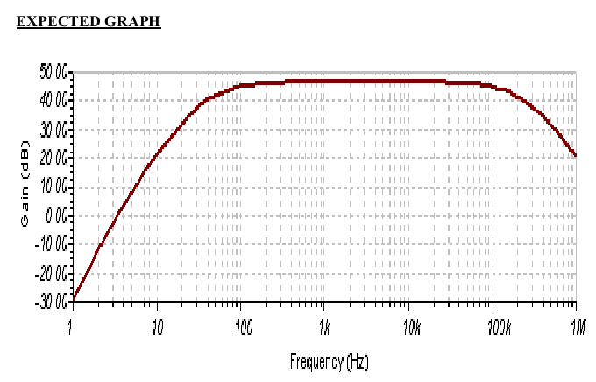

Slide 22
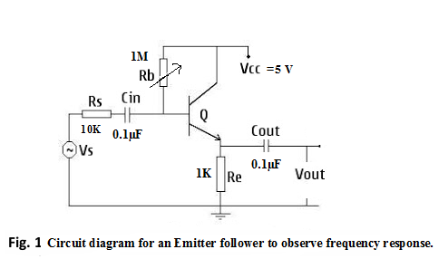
Experimental circuit: Circuit diagram for an Emitter follower to observe frequency response.

Slide 23
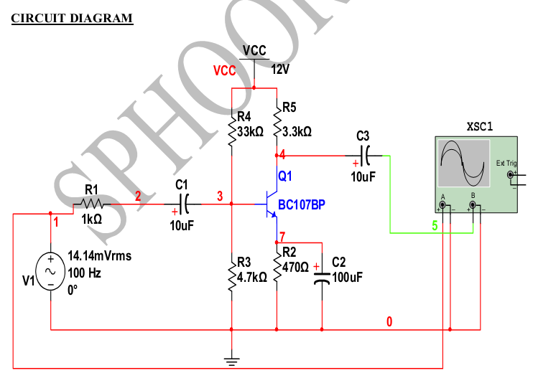
OR

Slide 24
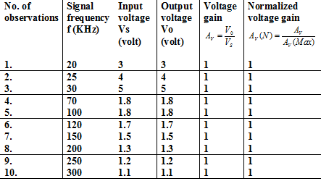
Table-1: Data for frequency response.

Slide 25

Input impedance of the emitter-follower circuit.
Measure the input impedance of the circuit
  The diagram on the left in Fig. 12 shows in a very straightforward manner that the input impedance can be determined experimentally by measuring the base-voltage and the input base-current We want to measure
  The diagrams on the right in Fig. 12 show two optional ways of implementing the measurement. For use an ac-voltage of amplitude ~ 20 mV.
  (Notice, in the first option an additional “small” resistance Rx has been introduced for the purpose of measuring .)

Slide 26
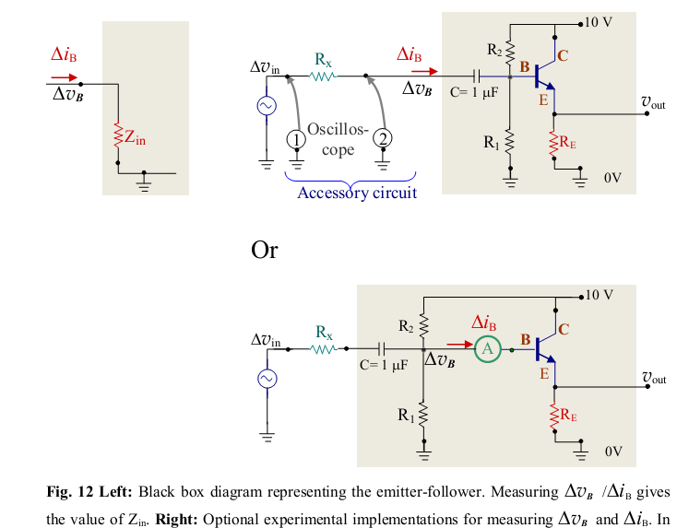

Slide 27
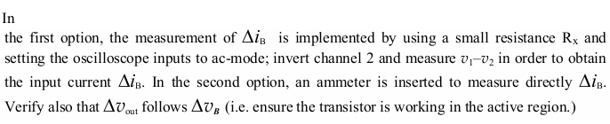

Slide 28
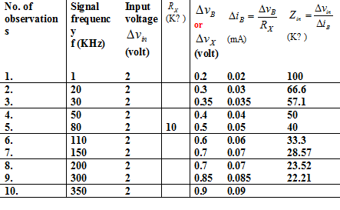
Table-2: Data for input impedance

Slide 29
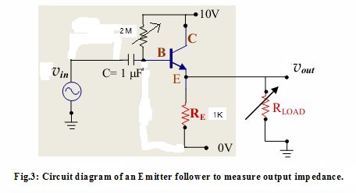
Fig.3: Circuit diagram of an Emitter follower to measure output impedance.

Slide 30
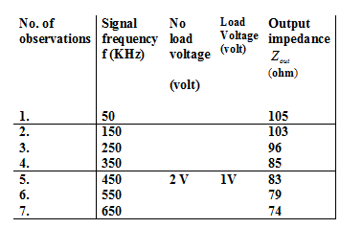
Table-3: Data for output impedance

Slide 31
Zener diode
Definition:
    Zener diode is heavily doped PN diode.
    When the reverse voltage reaches breakdown voltage in normal PN diode the current through the junction and the power dissipated at the junction will be high.
    Such an operation is destructive and the diode gets damaged.
    Diodes can be designed with adequate power dissipation capabilities to operate in the breakdown region.
    One such diode is known as Zener diode.

Slide 32

Zener diode
The following points may be Zener diode:
    It is like an ordinary diode except that it is properly doped so as to have a sharp breakdown voltage.
    It is always reverse connected i.e. it is always biased.
    It has sharp breakdown voltage, called Zener voltage
    When forward biased, it characteristics are just those of ordinary diode.
    It is not immediately burnt just because it has entered the breakdown voltage.

Slide 33
Uses of Zener diode
Uses of Zener diode:
    As a stabilization ( The process of making operating point independent of temperature changes or variations in transistor parameters is known as Stabilization.)
    As a protective device.
    As a Limiter
    Making square wave

Slide 34
Darlington amplifier or Why can we use Darlington amplifier?
Darlington amplifier:
    Sometimes, the current gain and input impedance of an Emitter follower are insufficient to meet the requirement.
    In order to increase the overall values of circuit current gain and input impedance, two transistors are connected in Emitter follower configuration as shown in fig.5, Such a circuit is called Darlington amplifier.
Application:
    When an Emitter follower can not provide the required high input impedance and current gain, the Darlington amplifier is used.
    Darlington pairs are used to
      amplify weak signal
      As a switch
      Not normally used for high frequency amplification.
      Used low frequency
      In practical, Darlington transistors are used for applications including
        Audio outputs
        Power supply outputs
        Display drivers and the like.

Slide 35
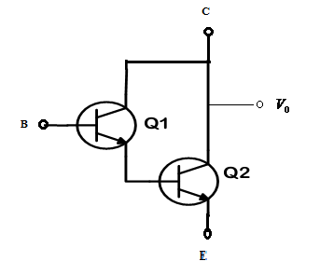
Fig.5: Darlington pair/amplifier

Slide 36
  A Darlington connection involves tying together the collectors of two transistors and the Emitter of the first to base of the second to provide a three-terminal device with very high current gain.
  The input resistance and current gain of a Darlington amplifier are very high, its output resistance very low and its voltage gain approximately ONE.
  To maintain high input resistance, the biasing of a Darlington amplifier must involve “Bootstrapping”
  In which practically, Equal voltages exist at the end of a resistor, so that it offers practically NO LOAD.

Slide 37
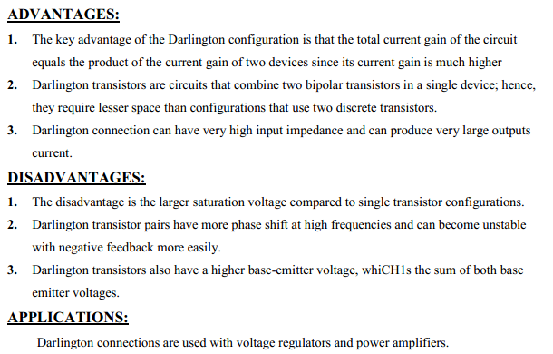
Darlington Configuration

Slide 38
Characteristics of the Darlington amplifier
Characteristics of the Darlington amplifier:
The characteristics of the Darlington amplifier are:
  1) It has a voltage gain of slightly less than 1 (A < 1).
  2) It has an extremely high input impedance to the base.
  3) It has a high current gain.
  4) It has an extremely low output impedance.
  5) Input and Output voltages currents are in phase.

Slide 39
    The characteristics of the Darlington amplifier are basically the same as the emitter follower.
    When a higher input impedance or current gain are required and/or a lower output impedance is needed than the emitter follower can provide, use a Darlington Amplifier.

Slide 40
The advantage of Darlington amplifier is its very high current gain and very high Zin.
It is used to isolate high impedance source from low impedance load.

Slide 41
Voltage Stabilizer
Voltage Stabilizer:
    Fig.4 shows the voltage stabilizer circuit diagram.
    When an Emitter follower is used as a voltage stabilizer, circuit supplies almost constant output voltage irrespective of variation of supply voltage and load resistance.

Slide 42
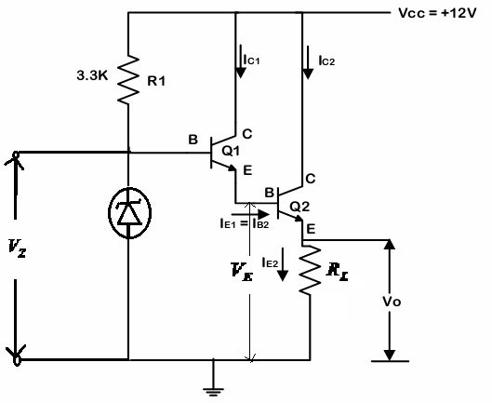
Fig.4: Circuit diagram for voltage stabilization

Slide 43

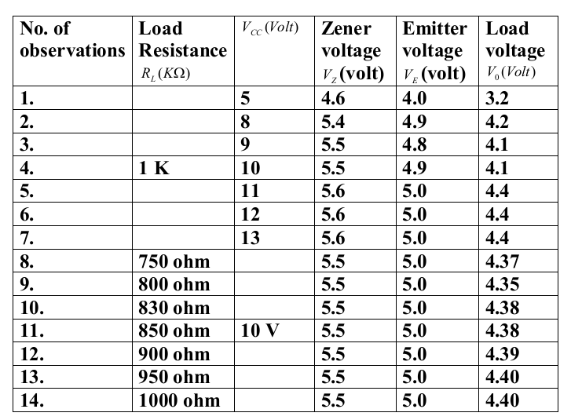
Table-4: Data for voltage Stabilizer when the load is Fixed to 1KΩ and Vcc is variable and when Vcc is fixed to 10V and is variable.

Slide 44
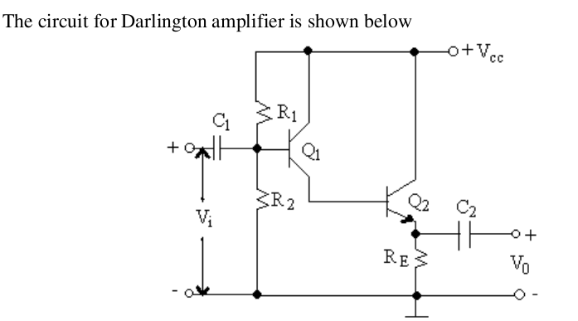

Slide 45
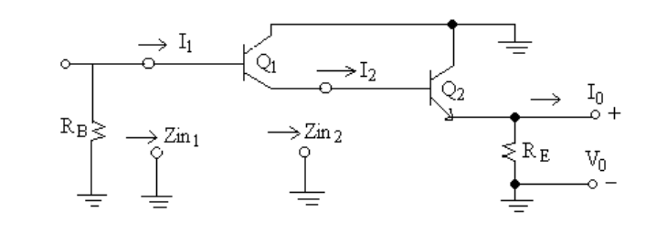

Slide 46
QUIZ AND VIVA QUESTION
Q. What is meant by emitter follower?
Answer:
    An emitter follower circuit shown in the figure is widely used in AC amplification circuits.
    The input and output of the emitter follower are the base and the emitter, respectively, therefore this circuit is also called common-collector circuit.

Slide 47
Why common-collector circuit is known as an emitter follower?
Answer:
    In emitter follower circuit, the output is taken from the emitter terminal of the transistor.
    It is actually a common collector configuration as in this the collector is grounded.
    The output is from emitter, thus called emitter follower.

Slide 48
Basic Electronics Objective Questions: Part - 1
[1] Removing bypass capacitor across the emitter leg resistor in a CE amplifier causes
a) Increase in current gain
b) Decrease in current gain
c) Increase in voltage gain
d) Decrease in voltage gain
Answer: D
[2] The important characteristic of emitter-follower is
a) High input impedance and high output impedance
b) High input impedance and low output impedance
c) Low input impedance and low output impedance
d) Low input impedance and high output impedance
Answer: B
[8] The common collector amplifier is also known as
a) Collector follower
b) Base follower
c) Emitter follower
d) Source follower

